Slide 1
React and Redux Developer

Slide 2
The React-Redux Node Package

Slide 3
Get introduced to Redux
- Redux library introduction
- Understand store, actions, and reducers
Install and set up Redux
- Install the Redux library

Slide 4

By the end of this lesson, you will be able to:
Demonstrate how to use Redux with the react-redux package
Install and set up react-redux package
Explain methods provided by the react-redux package
Integrate Redux with a React app

Slide 5
Introduction to the React-Redux Package

Slide 6

Introduction to the React-Redux Package
Official React bindings for Redux
Enhanced performance and flexibility
React 16.8.3 or later versions for installation
A better abstraction for using Redux with React
Made by creators of Redux
Command to install:
Notes:
As of React Native 0.18, React Redux 5.x should work with React Native.
The react-redux library exists to seamlessly integrate redux’s state management into a React application.

Slide 7
Features of React-Redux

Slide 8
Features of React-Redux
Key features of the react-redux package:
Provider Component
Connect Method
Provider provides the store to its child Components
Connect lets you connect your Components to the redux store provided by the Provider

Slide 9
Provider
Makes it possible for Redux to pass data from the store to any React Component that needs it
Makes the Redux store available to any nested Components
Uses React’s context feature to make this work
Is usually rendered at the top level, with the entire app’s Component tree inside of it
Can’t use a connected Component unless it is nested inside a <Provider>
Notes:
Since any React Component in a React Redux app can be connected, most applications will render a <Provider> at the top level, with the entire app’s Component tree inside of it.

Slide 10
Connect()
Connects a React Component to a Redux store
Provides its connected Component with the data it needs from the store
Provides the connected Component with the functions it needs to dispatch actions to the store
Does not modify the Component class passed to it
Returns a new, connected Component class wrapping the Component you passed in

Slide 11
Connect()
Connect has the following parameters:
MyComponent: The Component which should receive store state, dispatch, or both
mapStateToProps(): A function that receives the current store and current props
mapStateToProps(): It returns what’s available to MyComponent as props
mapDispatchToProps(): It allows you to wrap action creators inside of dispatch
Notes:
The mapStateToProps and mapDispatchToProps deals with the Redux store’s state and dispatch, respectively. state and dispatch will be supplied to mapStateToProps or mapDispatchToProps functions as the first argument.

Slide 12

mapStateToProps
A function that lets connect() know how to map specific parts of the store’s state into usable props
It allows you to specify which data from the store should be passed to your React Component
It takes a maximum of two parameters, state and ownProps?
state: Is the state of the Redux store
ownProps?: Gives access to props passed into a connected Component
It returns a plain object, which will be merged into the wrapped Component’s props
Notes:
If a mapStateToProps function is specified, the new wrapper Component will subscribe to Redux store updates. This means that any time the store is updated, mapStateToProps will be called. If you don't want to subscribe to store updates, pass null or undefined in place of mapStateToProps.
An Object created by literal notation or new Object is known as plain object.

Slide 13

mapDispatchToProps
Is the second parameter passed to connect()
Can either be an object or a function or can also be not supplied
Binds dispatch() to your action creators before they hit your Component
Makes the code clean
Takes a maximum of two parameters, dispatch and ownProps?
Notes:
If your mapDispatchToProps is declared as a function taking one parameter, it will be given the dispatch of your store.
If your mapDispatchToProps function is declared as taking two parameters, it will be called with dispatch as the first parameter and the props passed to the wrapper Component as the second parameter, and will be re-invoked whenever the connected Component receives new props.

Slide 14
Reducer Composition

Slide 15
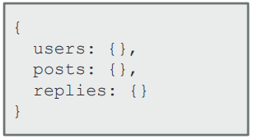
Reducer Composition
It is the process of separating reducers to handle distinct and independent slices of state.
Multiple reducers will be required to manage different aspects of the Redux store as the application grows.
A reducer will receive a section of state and an action and return a new, modified section of that state.
The process can be broken down into two steps:
Creating multiple reducers
Using Redux.combineReducers() method

Slide 16
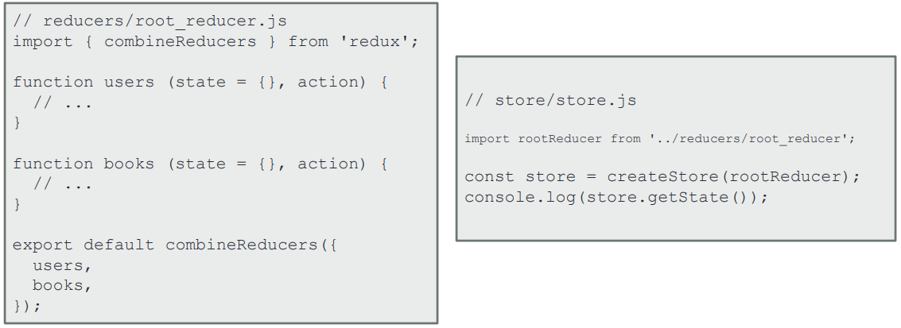
combineReducers()
combineReducers() is a helper function provided by Redux that turns an object whose values are different reducing functions into a single reducing function.
We, then, pass this single "root reducer" into createStore() to create the application's store.
Notes:
The resulting reducer calls every child reducer, and gathers their results into a single state object. The state produced by combineReducers() namespaces the states of each reducer under their keys as passed to combineReducers()

Slide 17
Adding Redux to React
Problem Statement: Build an enhanced version of the blogger app that uses Redux.

Slide 18
Assisted Practice: Guidelines
Steps to add Redux to a React app:
Identify the application state needed to create the Redux store.
Code reducers to generate various parts of the store.
Create the store using createStore() and combineReducers().

Slide 19
Normalization

Slide 20
Normalization
Normalizing Redux store will lead to efficient and consistent queries
To normalize your redux store:
Do not duplicate data
Favor creating references instead
Keep your store as shallow as possible
Normalization increases performance and minimizes complexity

Slide 21
Middleware

Slide 22
Middleware
Is the software between dispatching an action and the moment it reaches a reducer
Intercepts an action before it reaches the reducer
Carries out a number of operations like:
Producing a side effect, for example, logging
Processing an action, for example, making an asynchronous HTTP request
Redirecting an action
Dispatching supplementary actions
Notes:
Middleware is created by composing functionality that wraps separate cross-cutting concerns which are not part of your main execution task. In Redux middleware, the main execution task is the store’s dispatch function.

Slide 23

Applying Middleware
createStore() takes in an optional enhancer argument.
applyMiddleware() can be used as the enhancer argument.
applyMiddleware() can accept multiple arguments.
We can apply more than one middleware to an app.
Middleware uses the curry syntax.
Currying is the process of partially providing input to a function that requires additional data.
It is also called partial application.

Slide 24
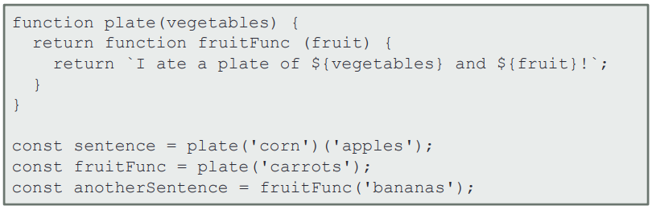
Currying
A curried function has several restructured arguments to accept the first argument and return a function that accepts the second argument and so on.
The code below shows a curried function plate which returns a second function, fruitFunc, that takes the second argument of plate as input argument.

Slide 25
Thunk

Slide 26
Thunk
The Redux store can only support synchronous flow of data.
Thunk is a middleware that helps support asynchronicity in a Redux app.
It is a wrapper for the store’s dispatch() method.
Thunk action creators are used to dispatch functions or Promises.
Run the command below to install thunk:
Notes:
Middleware is created by composing functionality that wraps separate cross-cutting concerns which are not part of your main execution task. In Redux middleware, the main execution task is the store’s dispatch function.

Slide 27
Middleware
Problem Statement: Add Redux Thunk to the blogger app

Slide 28
Assisted Practice: Guidelines
Steps to include Redux Thunk in a React app:
Add Redux Thunk middleware to the app.
Make the store available to all components using <Provider>.
Modify action creators to dispatch various application actions.
Make state and action creators available via props using connect().
Run npm start to run the updated web app.

Slide 30
Which of the following is not true about the provider Component?
1
Provider is a way of passing down the state to other React Components in an app.
Provider is another term for connect.
A provider is usually rendered at the top level in a React app.
You can’t use a connected Component unless it is nested inside a <Provider>.

Slide 31
Which of the following is not true about the provider Component?
1
Provider is a way of passing down the state to other React Components in an app.
Provider is another term for connect.
A provider is usually rendered at the top level in a React app.
You can’t use a connected Component unless it is nested inside a <Provider>.
b
Provider is not another term for connect. The Provider Component makes the Redux store available to any nested Components wrapped in the connect() function.

Slide 32
What is a currying function?
2
A function taking two functions as arguments and returning the second argument
A function taking no arguments and returning nothing
A function taking two arguments and returning a function which takes the second argument
A function taking no arguments and returning a function

Slide 33
What is a currying function?
2
A function taking two functions as arguments and returning the second argument
A function taking no arguments and returning nothing
A function taking two arguments and returning a function which takes the second argument
A function taking no arguments and returning a function
c
A currying function is a function of several arguments rewritten such that it accepts the first argument and returns a function that accepts the second argument.

Slide 34
What is a Thunk?
3
A Thunk is an alternative to a Promise.
A Thunk is an asynchronous function.
A Thunk is an action object.
A Thunk is a middleware used to handle asynchronous actions in Redux.

Slide 35
What is a Thunk?
3
A Thunk is an alternative to a Promise.
A Thunk is an asynchronous function.
A Thunk is an action object.
A Thunk is a middleware used to handle asynchronous actions in Redux.
d
A Thunk is a popular middleware used to handle asynchronous actions in Redux.
Notes:
Redux-Thunk middleware allows you to write action creators that return a function instead of the typical action object. The thunk can then be used to delay the dispatch of an action until the fulfillment of an asynchronous line of code

Slide 36
The react-redux package makes it easy to use Redux with React.
React-redux package has two main building blocks, Provider and connect
Provider provides the store and connect() connects Components to the store.
The package allows combining reducers.
There’s a middleware between dispatching actions and reducers and it uses curry syntax.

Slide 37
Building an Event Finder App in React
Problem Statement:
You are given a project to build a React app where users can view and publish upcoming events.
The tasks you are responsible for:
Building the application in React
Setting up a JSON server for testing
Managing state using Redux

Slide 38

Background of the Project Statement
You are a web developer at a company called FindMyMovies.
The company has decided to launch a new app called FindMyEvents where users can view and promote upcoming events in their region.
Backend development has been outsourced and front-end will be developed in-house. During the sprint planning, you agreed to take the lead on this project and develop an app that will let users find events using the APIs that the backend engineers will provide.

Slide 39
You Are Asked to Do
Build the app in React
Make the app responsive
Maintain one source of truth for state management
Build a placeholder backend for app development and testing
Add functionalities for users to create, view, and delete events
Implement routing for navigating within the app
The goal of the company is to deliver a high-end quality product as early as possible.

Slide 40







You must use the following
Code Editor: Sublime Text or Visual Studio
Programming language: React Js
Redux
Google Chrome
Bootstrap
JSON Server

